Slide 1
Introduction to Robotics Course no. 1
Andrei Dumitriu
andrei.dumitriu@fmi.unibuc.ro
Faculty of Mathematics and Computer Science
University of Bucharest

Slide 2
About the course: details
Grading:
1p laboratory, course and/or relevant extra-curricular activity
4p weekly homeworks
2.5p project 1: matrix game (bomberman, tetris etc)
2.5p project 2: line follower
1p: bonus (activities and/or anything extra on the ones above)
Total: 11p

Slide 3
Today’s agenda
Arduino - what is it?
Electrical Current
Voltage, Current and Resistance
AC vs DC
Electric components
Voltage Source
Resistors
Capacitors
Diodes
Ohm’s law
Reading a datasheet

Slide 4
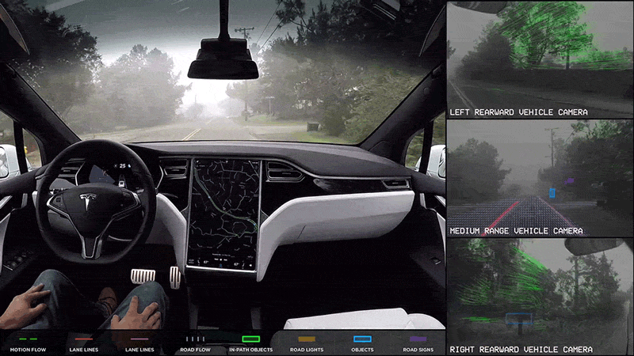
Sense. Analyse. Act.

Slide 5
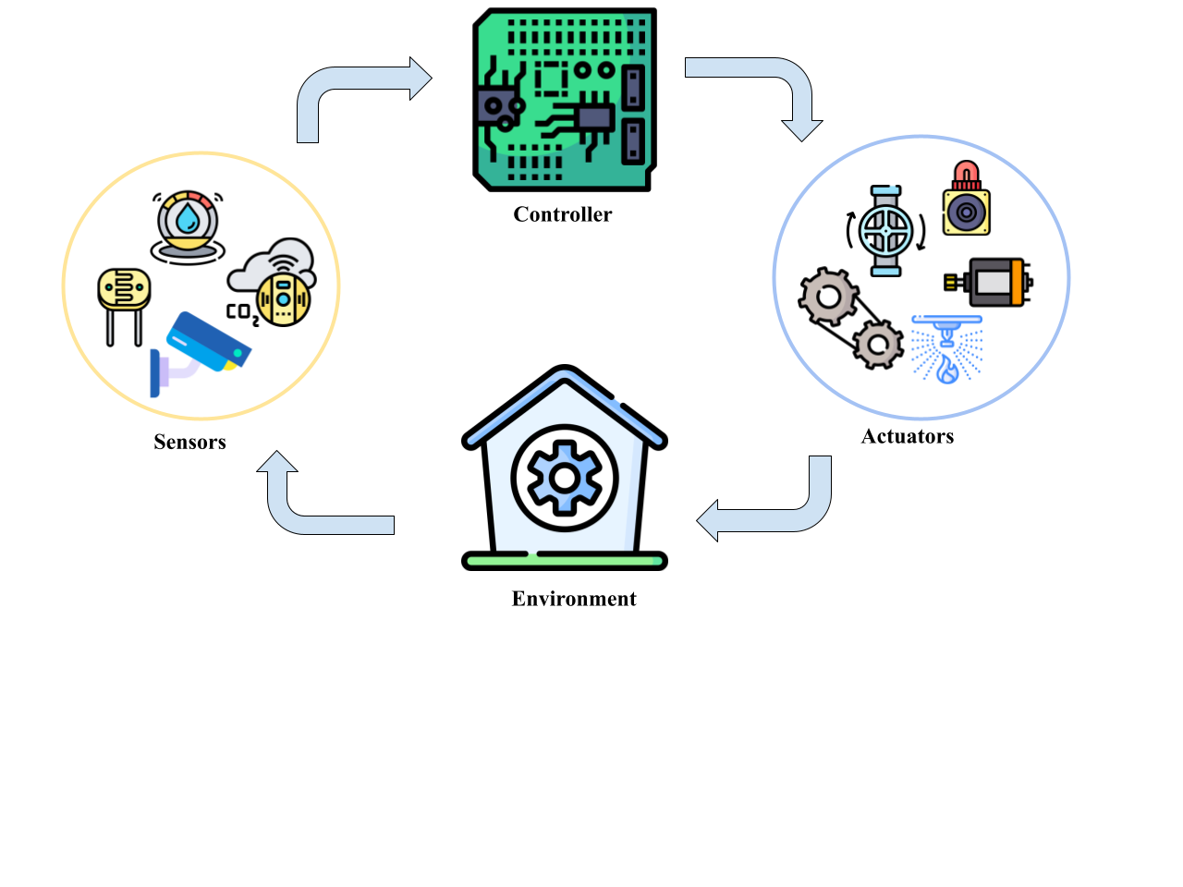
Sense. Analyse. Act.

Slide 6
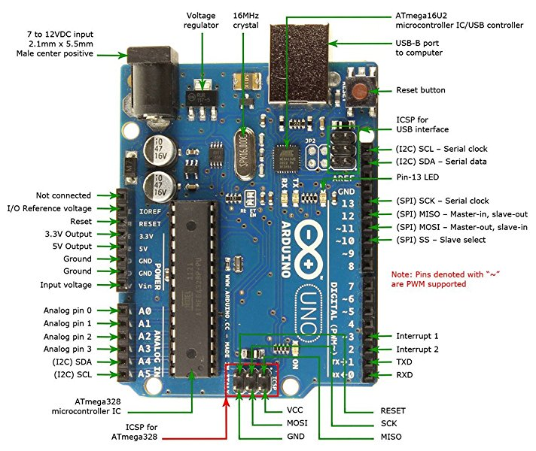
Arduino Uno board

Slide 7
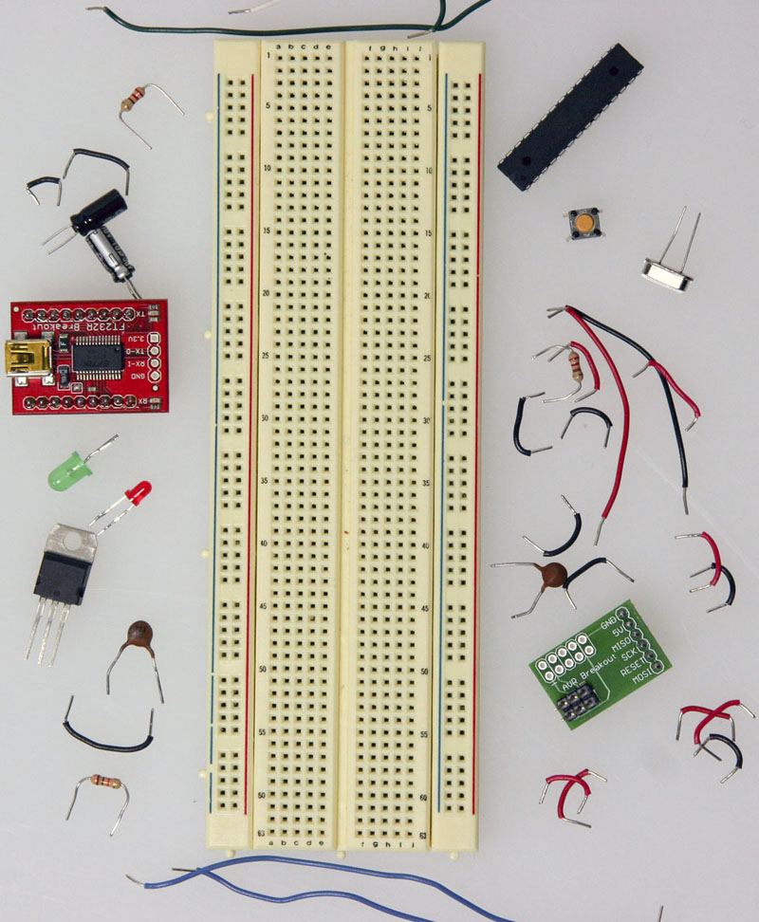
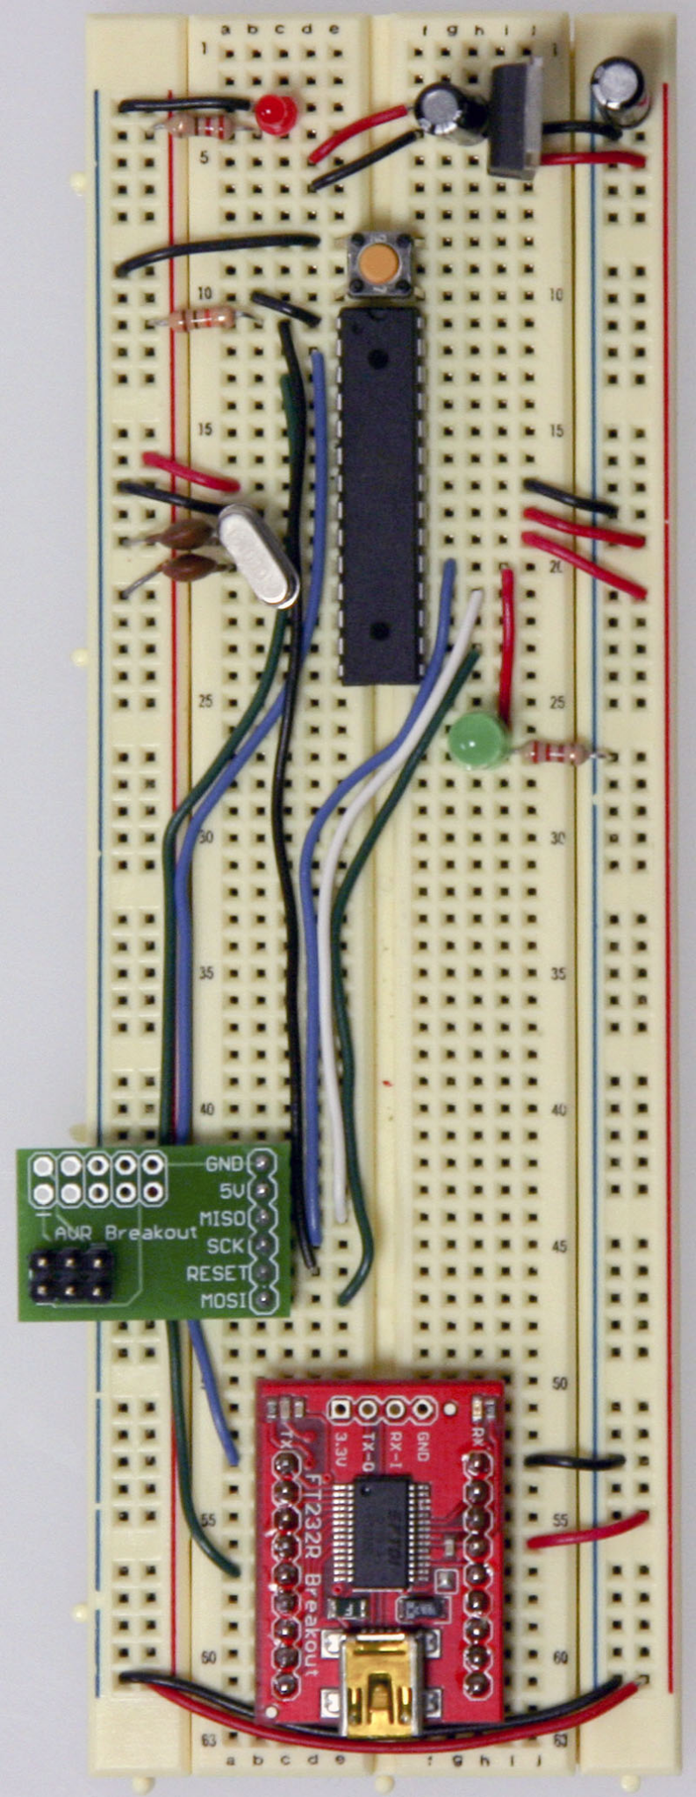
Arduino Uno board on a breadboard
https://www.arduino.cc/en/main/standalone
https://www.sciencebuddies.org/science-fair-projects/references/how-to-use-a-breadboard

Slide 8
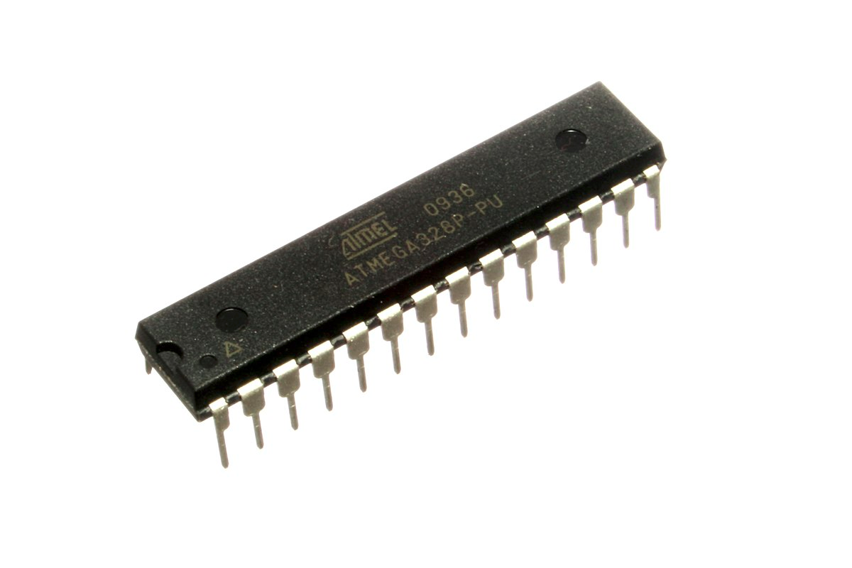
This is a microcontroller
(AVR ATmega328)

Slide 9
But what’s a microcontroller?
An integrated circuit
Basically a tiny computer
Can run small, simple software programs
Low power enough to be run on simple batteries for days
Fast enough to process data efficiently
A typical microcontroller includes a processor, memory and input/output (I/O) peripherals on a single chip

Slide 10
WARNING
We will work with the HIGH-LEVEL concepts and integrated circuits.
It is not our purpose to design IC, but to understand:
how to select an IC
how to connect an IC
how to understand its limits
how to use its capabilities

Slide 11
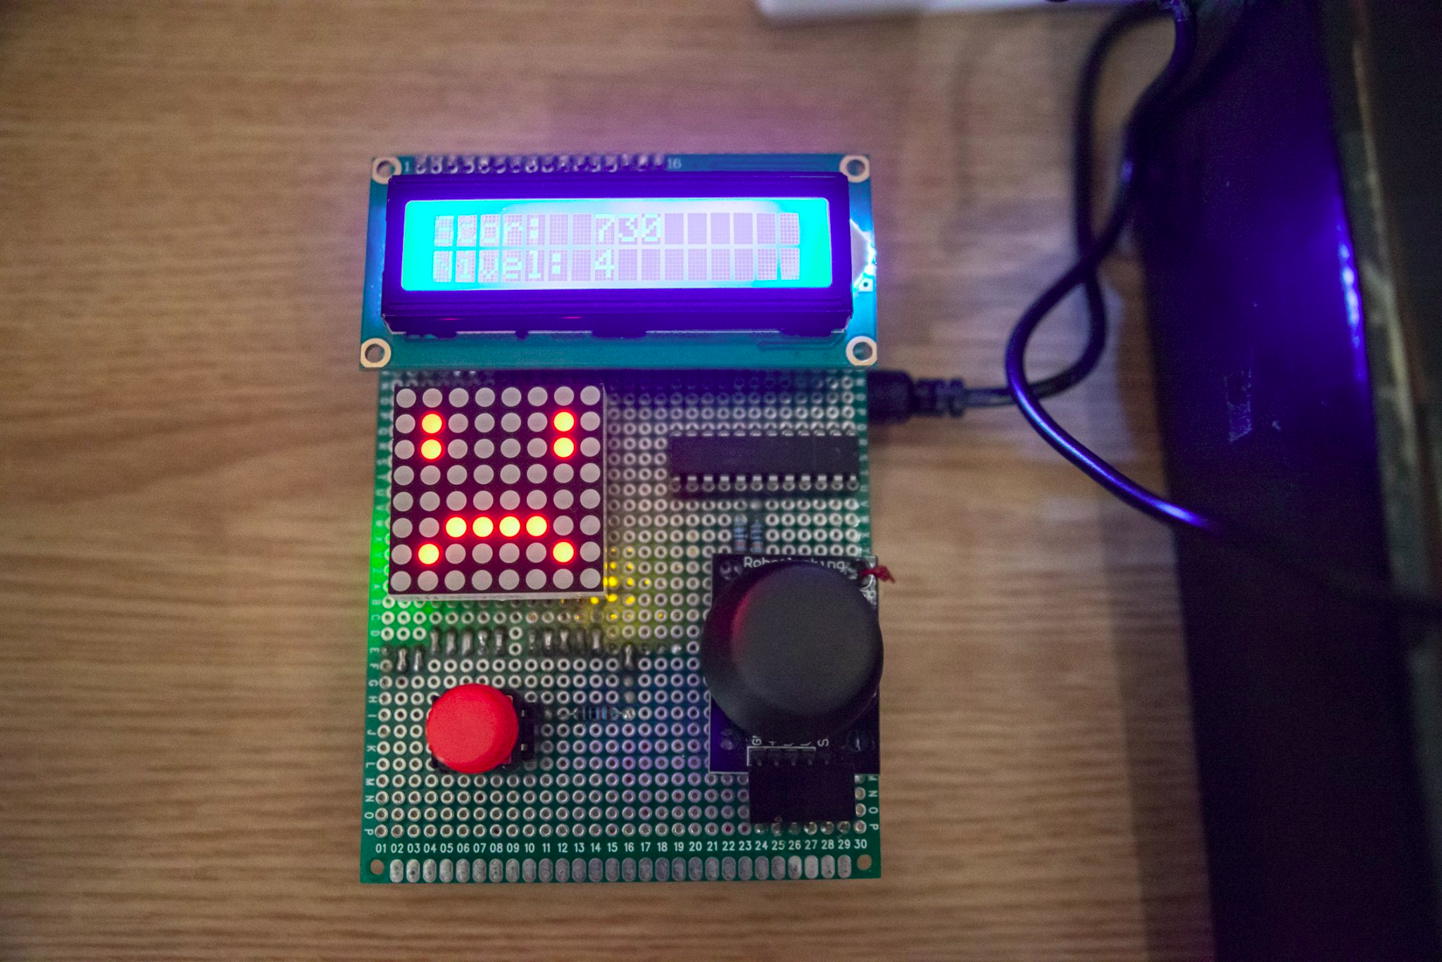
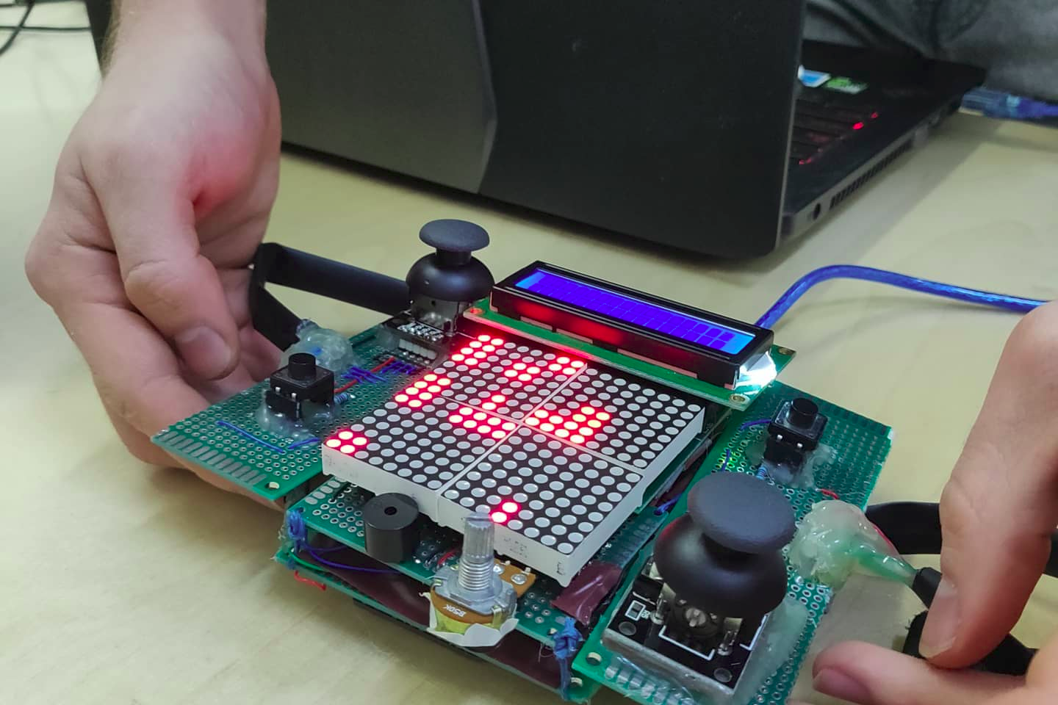

Slide 12
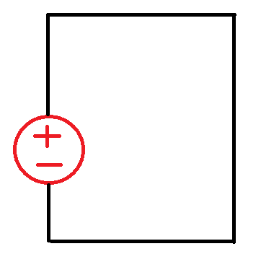
Electric Current
Before you understanding those, though, you need to understand the fundamentals, starting with the electrical current.
Electric circuit: a closed loop that carries electricity.
Picture on the right is correct, but what’s wrong
with it?
https://www.youtube.com/watch?v=gYvXIv7Sj3s

Slide 13
Electric circuit
Before you understanding those, though, you need to understand the fundamentals, starting with the electrical current.
Electric circuit: a closed loop that carries electricity.
Picture on the right is correct, but what’s wrong
with it?
In a circuit like this there is no resistance, which can
cause overheat and even fire.
Usually there is a consumer in the circuit.

Slide 14
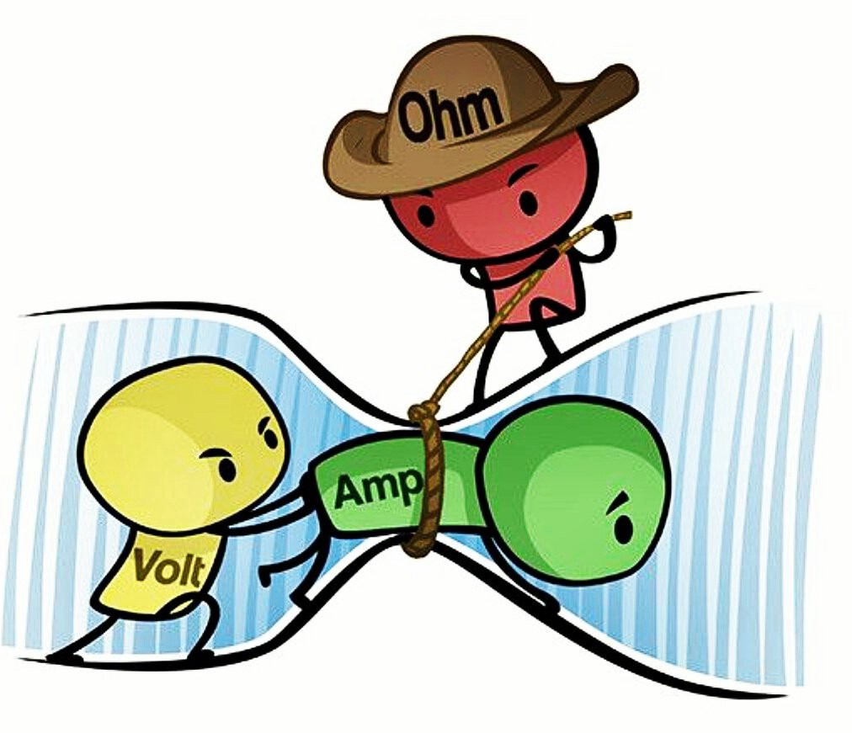
Current, Voltage and Resistance

Slide 15
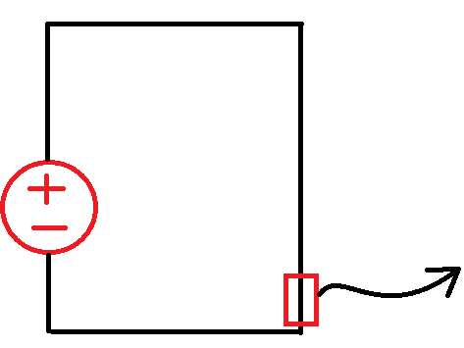
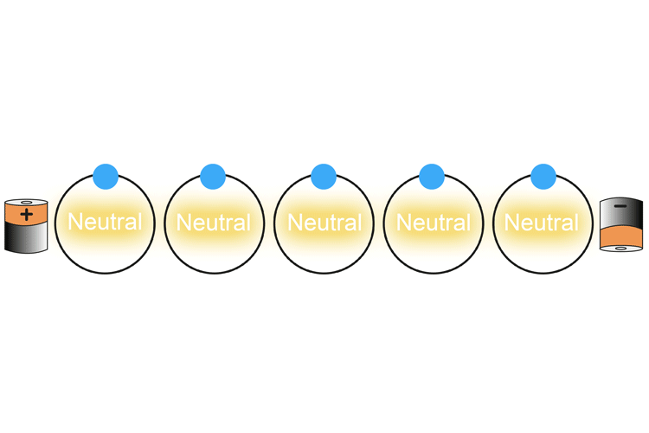
Electric Current
Electric current: flow of electrons in a circuit.
It is the movement, do not confuse it with voltage.
Some analogies include a water current that moves the boat or a wind current that pushes the sail.
Why do electrons “jump” from one atom to the other?
Basically, it’s the potential (the voltage) that pushes the electrons. Each ion (positively charged atom) attracts an electron, creating a new ion. We’ll leave some info for diving deeper.
*Source

Slide 16
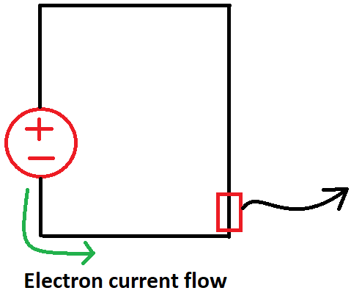
Electric Current
Understanding the difference between conventional electric current flow (hole current, because it leaves a “hole” behind) and electron current flow.
Reasons vary from historic decisions and not wanting to have a lot of “-” in our equations.
*Source

Slide 17
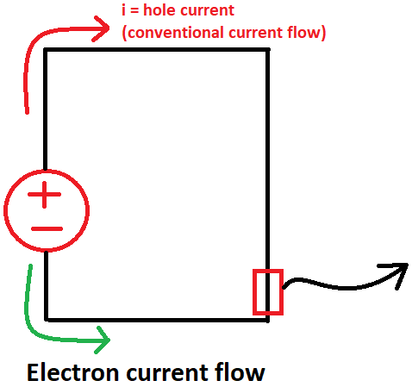
Electric Current
Imagine instead of seeing the electrons (thus, the negative charge) moving from minus to plus, you can say - and it would be mathematically correct - that the positive charge moves from plus to minus.
We will be working with conventional current flow.
*Source

Slide 18
Electric Current
This is all very basic, yet super important concept. Take a moment to internalize it. All the calculations are done using hole current, even if in reality the electrons are moving from minus to plus.
*Source

Slide 19
Electric Current
Units = Ampere (Amp, or “A”).
We will be working with milliamps (mA)
Amps is the stuff that kills you.
*Source

Slide 20
Electric Current
To sum it up:
current in real life is the flow of electrons
in all circuits we’re not gonna talk about that
we’re gonna say that current comes out the positive terminal and that the unit of measure is the ampere.

Slide 21
Voltage
Do not confuse with current.
Voltage = the “push” that causes current to flow.
You cannot have any current flowing without something to push it.
When you see that “you can be killed by 10000 volts” it’s incorrectly said. The current kills you, the voltage only causes that current.
Think of blowing through a straw. The air movement is the current, the pressure is the voltage. (can you guess which is resistance?)

Slide 22
Voltage
Do not confuse with current.
Voltage = the “push” that causes current to flow.
Units = Volt (V)
We will be working mostly with 5V, but generally with an interval between 3.3V and 12V.

Slide 23
Resistance
It opposes the current flow in a circuit.
Think about the straw. What happens if you increase or decrease the diameter?
Units = Ohm (Ω)
We will be working with units from 110 ohms to few thousand ohms

Slide 24
Current, Voltage and Resistance

Slide 25

AC/DC
AC - Alternating Current - Current moves back and forth.
The wall sockets that you use have alternating current.
DC - Direct Current - Constant current flow.
All the batteries you used generate direct current. It gives you constant voltage at the source location (in reality, the battery does die down and current gets weaker, but in a snapshot it’s constant).

Slide 26
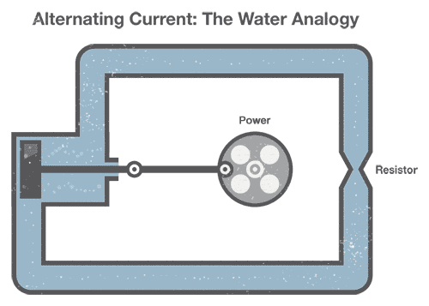
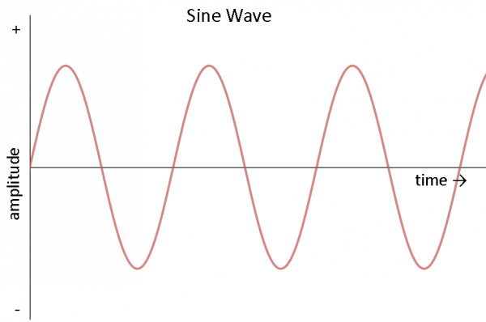
AC
The sine wave is the most common waveform for AC, but not the only one.
https://www.youtube.com/watch?v=WhATjUHgzxQ

Slide 27
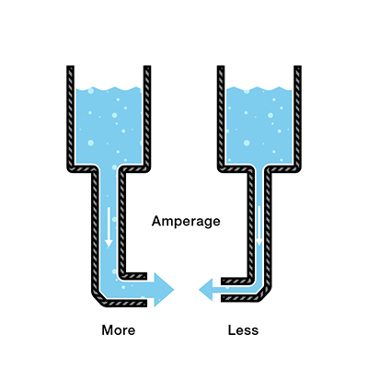
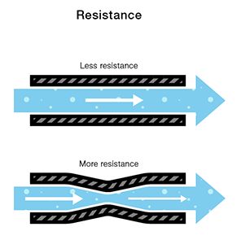
DC

Slide 28
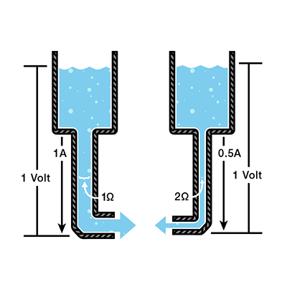
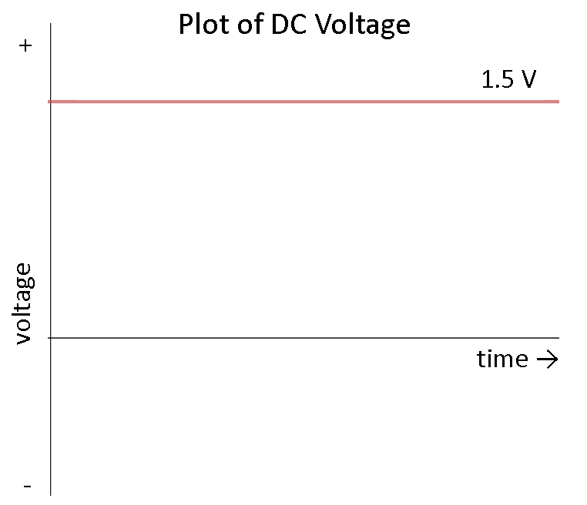
DC

Slide 29
AC/DC
The choice for AC over DC in households has been due to AC being easier to transport over long distances.
It’s also easier to generate at power plants etc since they generate heat that creates steam and moves a generator. The wind farms work the same.
Exceptions are batteries, that have a chemical reaction, and solar panels. These generate direct current.
We will not be directly using AC in this course.
Q: why isn’t the light flickering in the house since you use AC?

Slide 30
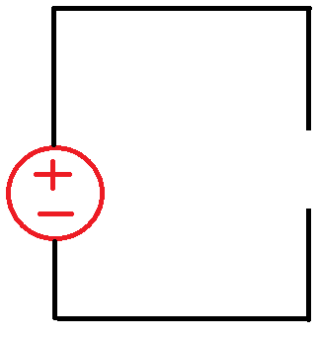
Open Circuit
An interrupted circuit through which current does not flow.

Slide 31
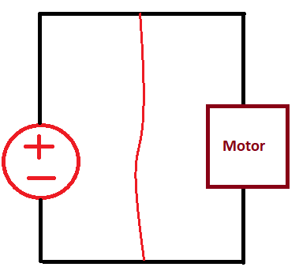
Short Circuit
When you have a circuit with a consumer, but inside it a piece of wire accidentally connects to two terminals (parts of the circuit).
What do you think will happen?

Slide 32
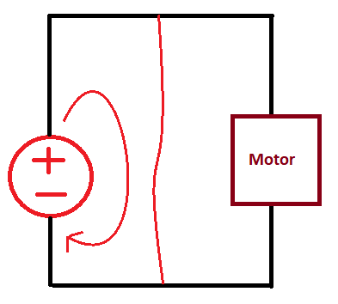
Short Circuit
When you have a circuit with a consumer, but inside it a piece of wire accidentally connects to two terminals (parts of the circuit).
What do you think will happen?
Remember the foam cutter?
It will generate a lot heat.
And maybe stop the current. Why?

Slide 33
Electrical Components
You might’ve heard of them in random conversations.
We’ll present a few and look at a big picture overview of what they do.

Slide 34
Electrical Source
Source Voltage or battery.
Most of the information we’ll present is taken from here: https://www.electronics-tutorials.ws/dccircuits/voltage-source.html

Slide 35
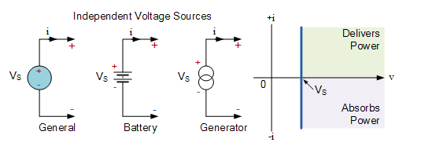
Electrical Source
Source Voltage or battery.

Slide 36
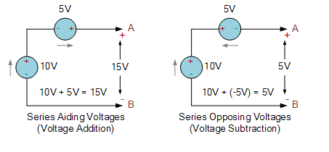
Electrical Source
Connecting sources.

Slide 37
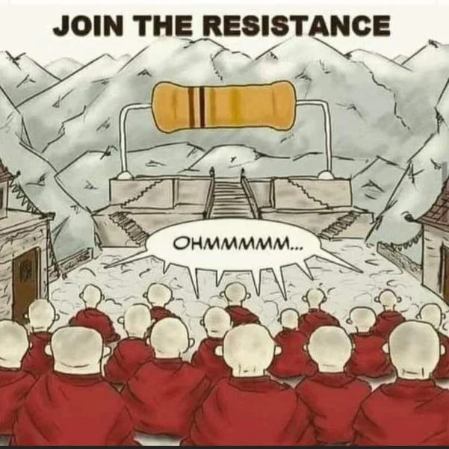
Resistor

Slide 38
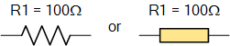
Rezistor
https://www.electronics-tutorials.ws/resistor/res_1.html

Slide 39
Resistors
Electrical components that limit current in a circuit
Their values can be calculated depending on the color bands
There can have, 3, 4, 5 and even 6 color bands, but we’ll mostly be using with 5. We need to use a table for identifying the value of the colors.
1st band: 1st digit of the value
2nd band: 2nd digit of the value
3rd band: 3rd digit of the value
4th band: multiplier
5th band: tolerance ---- aka, error
6th band: temperature coefficient
For this course, we can ignore tolerance and temperature coefficient

Slide 40
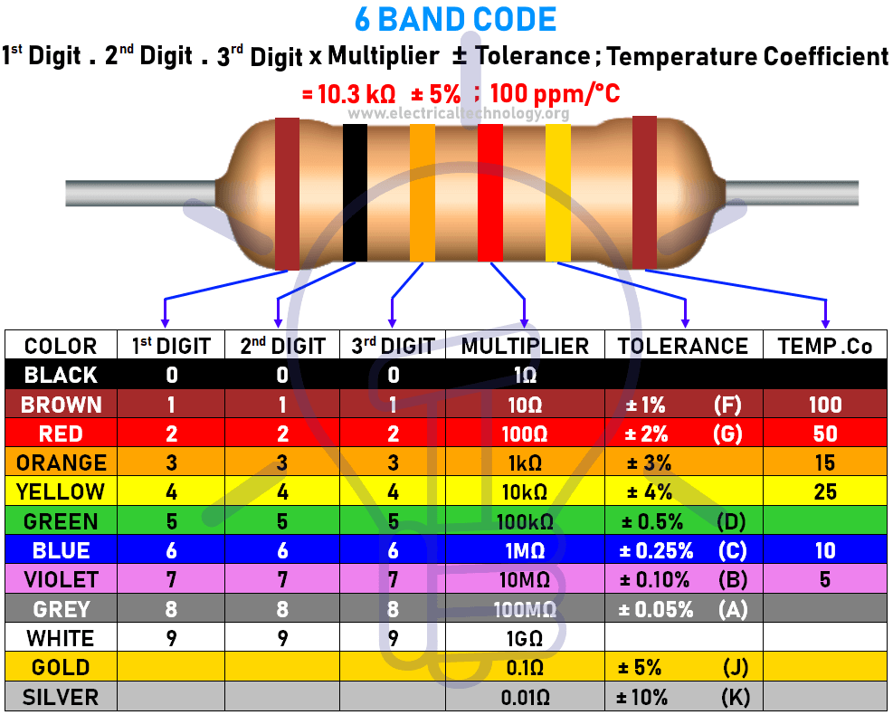
Resistor value

Slide 41
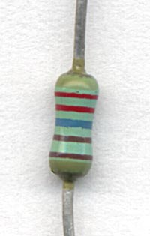
Resistors
In order to orient them correctly, pay careful attention to the tolerance ring, as it should be farther apart, but this is not always obvious.
For cheap and easy to find resistors, the tolerance ring is often gold (5%, 4 band, E12) or red (2%, 5 band, E96)
What value does this resistor have?

Slide 42
Resistors
In order to orient them correctly, pay careful attention to the tolerance ring, as it should be farther apart, but this is not always obvious.
For cheap and easy to find resistors, the tolerance ring is often gold (5%, 4 band, E12) or red (2%, 5 band, E96)
A 2260 Ω, 1% precision resistor with 5 color bands (E96 series), from top 2-2-6-1-1; the last two brown bands indicate the multiplier (×10), and the 1% tolerance. The larger gap before the tolerance band is somewhat difficult to distinguish.

Slide 43
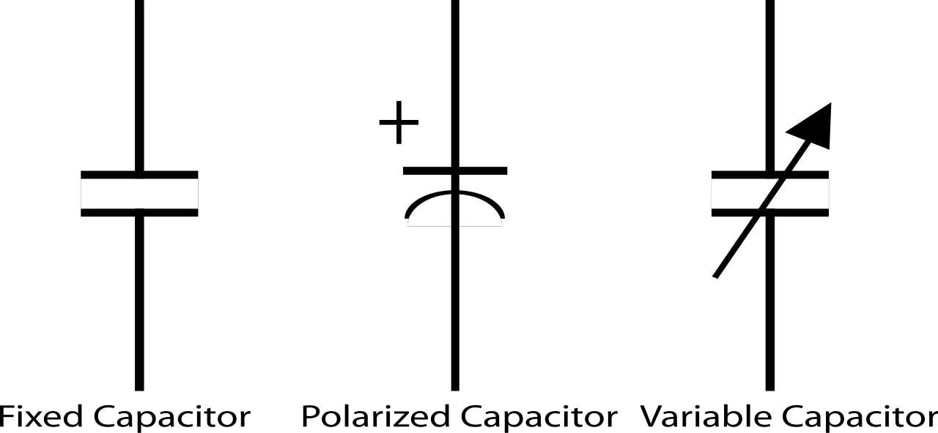
Capacitor (sau condensator electric)
https://www.electronics-tutorials.ws/capacitor/cap_1.html
The capacitor is a component which has the ability or “capacity” to store energy in the form of an electrical charge producing a potential difference (Static Voltage) across its plates, much like a small rechargeable battery.
Has faster discharge rate than a battery.
Ever heard a blitz charging?

Slide 44
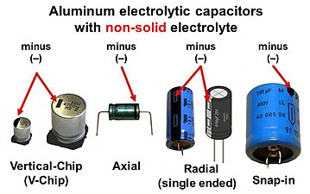
Capacitor (sau condensator electric)
Unit = Farad(F)
1F is a huge value, we will use µF usually
Are used to also absorb noise in a system

Slide 45
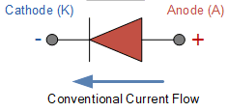
Diode
https://www.electronics-tutorials.ws/diode/diode_1.html
Diodes are basic unidirectional semiconductor devices that will only allow current to flow through them in one direction only, acting more like a one way electrical valve (Forward Biased Condition).
Can you image how such a component would be built?

Slide 46
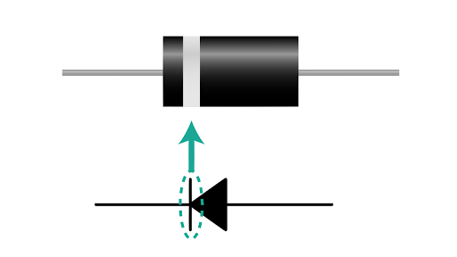
Diode
https://www.electronics-tutorials.ws/diode/diode_1.html
Diodes are basic unidirectional semiconductor devices that will only allow current to flow through them in one direction only, acting more like a one way electrical valve, (Forward Biased Condition).
Can you image how such a component would be built?

Slide 47
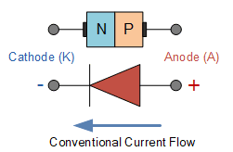
Diode
https://www.electronics-tutorials.ws/diode/diode_1.html
Diodes are basic unidirectional semiconductor devices that will only allow current to flow through them in one direction only, acting more like a one way electrical valve (Forward Biased Condition).
Can you image how such a component would be built?

Slide 48
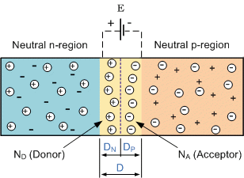
PN Junction Diode
https://www.electronics-tutorials.ws/diode/diode_3.html
More precisely:

Slide 49
LED
What does it stand for?

Slide 50
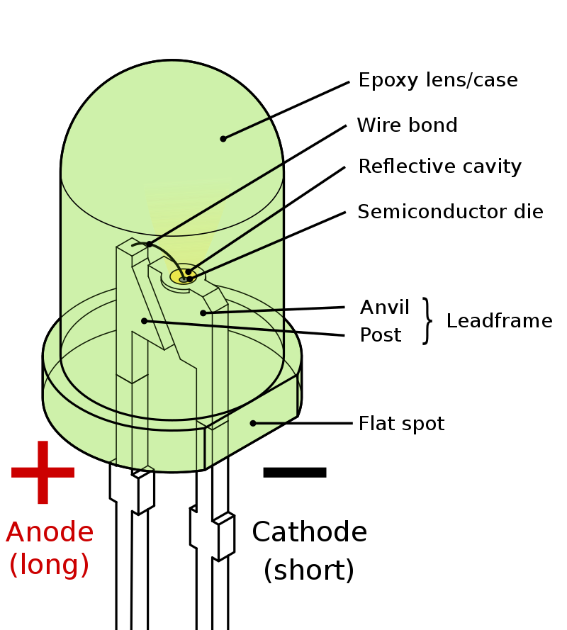
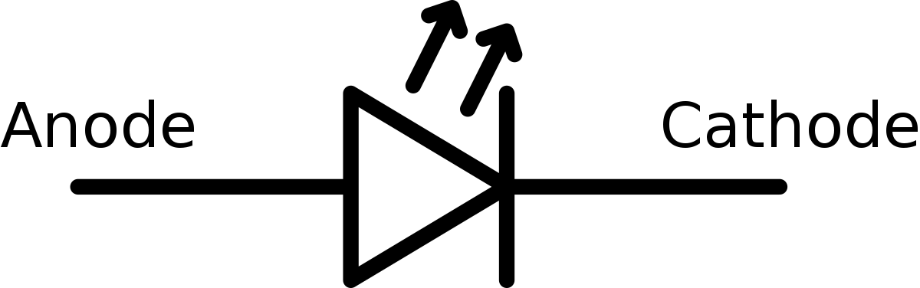
LED - Light Emitting Diode
A light-emitting diode (LED) is a semiconductor light source that emits light when current flows through it.
Aka a diode that just happens to emit light.
The invention of the blue LED won the nobel prize: https://www.bbc.com/news/science-environment-29518521

Slide 51
Transistor
Surely you’ve heard of it.
Super important.
Present in pretty much every electrical component.
Most of the technology in the past 50+ years has been made possible by advancing transistors.
It’s hard to overstate their importance.
It can do 2 things:
Act as an electronic switch with nothing moving inside (main use)
Act as an amplifier

Slide 52
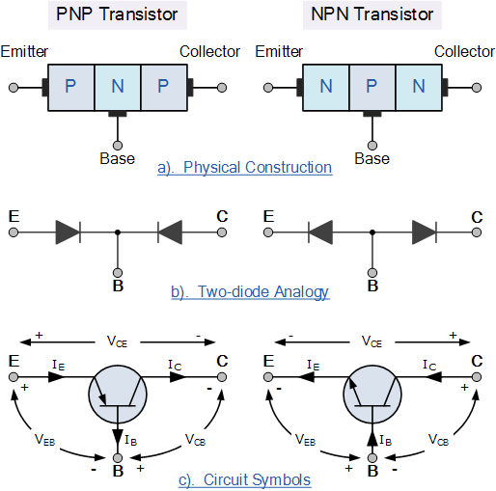
Transistor

Slide 53
Transistor
Take a few million of these and you can do lots of calculations very, very quickly.
You basically have a digital binary system.
They can turn on and off very fast.
Chips progressed by making transistors faster, smaller and putting more on chips (roughly).

Slide 54
Ohm’s Law
Super simple - super important, serving as a foundation.
We’ve talked about:
Current being what actually moves in a system.
Voltage being what pushes and creates movement.
Resistance being whatever is in the way and trying to slow down the movement.
We are going to look at very simple systems and apply Ohm’s Law.

Slide 55
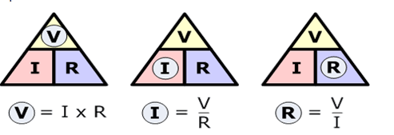
Ohm’s Law
V = IR
V -> Voltage (Romanian: U)
I -> Current
R -> Resistance

Slide 56
Ohm’s Law
Think about it logically. I = V / R
Increasing the voltage increases the current
Increasing the resistance decreases the voltage

Slide 57
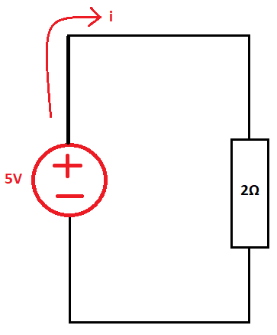
Ohm’s Law
Some simple examples
What’s the current here?

Slide 58
Ohm’s Law
Some simple examples
What’s the current here?
I = V / R -> I = 5V / 2Ω -> I = 2.5 A (quite a lot)

Slide 59
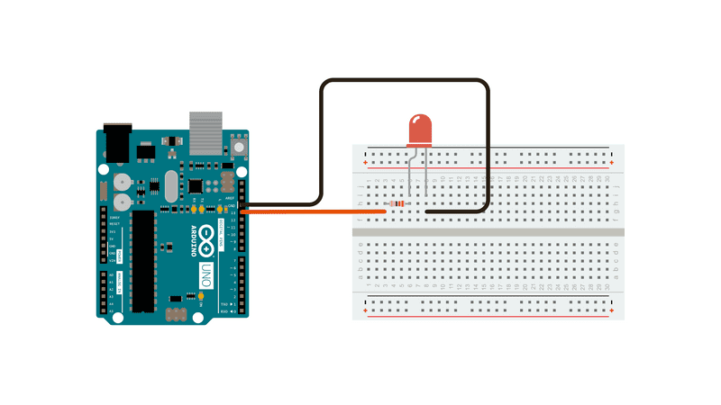
Ohm’s Law
Practical example: let’s light up an LED. The arduino provides 5V.
What resistor value do we use? R = V / I -> R = V / 20mA

Slide 60
Ohm’s Law
Practical example: let’s light up an LED. The arduino provides 5V.
First, let’s check the datasheet for the LED: https://learn.adafruit.com/all-about-leds/the-led-datasheet

Slide 61
Ohm’s Law
We learnt that:
Arduino provides 5V
The LED has a running current of (about) 20mA
The LED has a voltage drop of 1.8V
The formula is: R = V / I (V = 3.2, I = 20mA)
What numbers do we plug in?

Slide 62
Ohm’s Law
Well, we calculate the “remaining voltage”:
V_remainder = V_in - V_drop

Slide 63
Ohm’s Law
Well, we calculate the “remaining voltage”:
V_remainder = V_in - V_drop
V_remainder = 5V - 1.8V = 3.2V

Slide 64
Ohm’s Law
Well, we calculate the “remaining voltage”:
V_remainder = V_in - V_drop
V_remainder = 5V - 1.8V = 3.2V
We know the desired current: 20mA

Slide 65
Ohm’s Law
Well, we calculate the “remaining voltage”:
V_remainder = V_in - V_drop
V_remainder = 5V - 1.8V = 3.2V
We know the desired current: 20mA
We apply the formula: R = V / I

Slide 66
Ohm’s Law
Well, we calculate the “remaining voltage”:
V_remainder = V_in - V_drop
V_remainder = 5V - 1.8V = 3.2V
We know the desired current: 20mA
We apply the formula: R = V / I
R = 3.2V / 20mA = 160 Ω
We will use 220 Ω (closest common value) or 330 Ω if we want it dimmer.

Slide 67
DC - maybe the difference makes more sense now

Slide 68
Useful Links
Electronics guide: https://www.electronics-tutorials.ws
Simple electronics guide:
Voltage, Current and Resistance: https://www.youtube.com/watch?v=OGa_b26eK2c
Overview of Circuit Components: https://www.youtube.com/watch?v=RHpo4wKo8pQ
Ohm’s Law: https://www.youtube.com/watch?v=lf0lMDZVwTI
Kirchoff’s Law:
KVL and KCL examples (haven’t watched it, but from the same series)
KVL: https://www.youtube.com/watch?v=6F_rmZ1nXFQ
Series and parallel circuits (long video)
Super useful channel: Basic electronics tutorials (list)
Resistor before or after LED?
How to use a breadboard
How to calculate correct resistor for LEDs
Detailed overview or resistors (pretty cool video)
Just use google, though. Each year I find resources that are better and better.

Slide 69

Source

Slide 70

Attendance check

